Slide 1
9/18 Biomolecular Electrostatics
This week’s lecture and lab are intended to help you achieve the following learning objectives:
Predict the pKa’s of titratable amino acids on a protein and protonation at a given pH. Summarize the qualitative relationship between electrostatic potential and pKa.
Compute and visualize the electrostatic potential of a protein. Compare the advantages and disadvantages of several representations.
At the end of this lecture, you should be able to explain, in a general sense, the
importance of electrostatics in biological macromolecules
origin of the Poisson-Boltzmann equation

Slide 2
Roles of Biomolecular Electrostatics
Electrostatics important in (at least)
protonation, influencing side chain pKa
binding for
steering, facilitating approach of species
complexation, as complementarity means lower potential energy
enzyme catalysis, as electric potential stabilizes transition state
solvation
Electrostatic potential usually conserved near functional sites
Thymidylate Synthase
blue isocontours +1 kT/e,
red isocontours -1 kT/e
From Fig 1 of Garg et al. (2015).

Slide 3
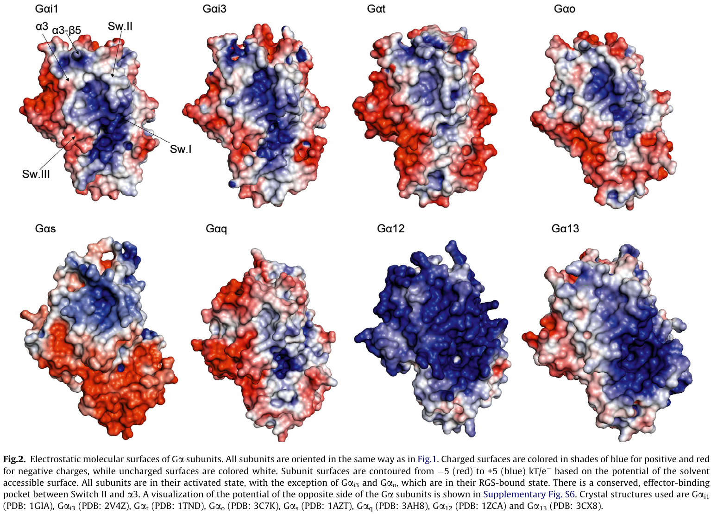
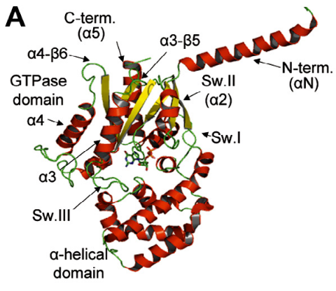
G proteins have distinct fingerprints
Baltoumas, F. A.; Theodoropoulou, M. C.; Hamodrakas, S. J. Interactions of the α-Subunits of Heterotrimeric G-Proteins with GPCRs, Effectors and RGS Proteins: A Critical Review and Analysis of Interacting Surfaces, Conformational Shifts, Structural Diversity and Electrostatic Potentials. Journal of Structural Biology 2013, 182 (3), 209–218. https://doi.org/10.1016/j.jsb.2013.03.004.

Slide 4
Protein Protonation
Which structure determination technique(s) have been used to identify the protonation of amino acid side chains?
X-ray crystallography
X-ray crystallography, at very high resolution
Nuclear magnetic resonance
Cryo-electron microscopy
None of the above

Slide 5
Histidine
As the side chain has a pKa ~ 7.0, imidazolium ion (B) and imidazole (A or C) are all present in physiological conditions
Which state(s) are stabilized by a negative electrostatic potential?
What can stabilize a specific form of imidazole?
https://spdbv.unil.ch/TheMolecularLevel/Goodies/Get2NoHistidine.html

Slide 6
Electrostatics is important in solvation
It is an implicit solvent model that does not account for specific water positions
Solvent is assumed to modify the dielectric constant
Coulomb’s law is $F=\frac{1}{4πϵ}\frac{Q_{1}Q_{2}}{r^{2}}$.
The permittivity ε is related to the permittivity of free space εo by the dielectric constant κ, ε = κεo.
~80 for water
~1 for the protein interior
The electrostatic component of the solvation energy is modeled as the difference between the energy in water and in vacuum

Slide 7
Modeling Electrostatics
In biological macromolecules, the electrostatic potential is usually calculated based on the Poisson-Boltzmann equation
The Poisson equation $∇⋅ϵ(r)∇ϕ(r)+4πρ(r)=0$ describes the potential $ϕ(r)$ due to a given charge density $ρ(r)$ and dielectric $ϵ(r)$. Atoms in the biomolecule are assumed to have a fixed charge.
The Poisson-Boltzmann equation assumes that (infinitely small) ions surround a biomolecule in accordance with the Boltzmann distribution
The PB equation is a partial differential equation that is solved numerically
The equation is often linearized to be more numerically stable

Slide 8
Electrostatic Screening
Ions “screen” the electrostatics between two charges
https://scipython.com/blog/the-debye-length/

Slide 9
Ion concentration effects
Potential contours (−0.5 (red) and +0.5 (blue) kT/e) around AGT-Ma at pH 7.4, 37 °C, at the indicated ionic strength.
from Dindo et al (2017) https://febs.onlinelibrary.wiley.com/doi/full/10.1111/febs.14269
What happens to the electrostatic potential as the ionic concentration is increased. Why?

Slide 10
Influences on biomolecular electrostatics
Which are influences on biomolecular electrostatics?
pH
Concentration of ions
Valency of ions (+1 vs. +2)
Identity and size of ions (Ca²⁺ vs Mg²⁺)
Which are accounted for by the Poisson-Boltzmann equation?
pH
Concentration of ions
Valency of ions (+1 vs. +2)
Identity and size of ions (Ca²⁺ vs Mg²⁺)

Slide 11
Review Questions
Discuss some of the ways in which electrostatics is important for the function of biological macromolecules
An equation often used to model the electrostatics of biological macromolecules is the Poisson-Boltzmann equation. Why does the equation have this name?
How can the Poisson-Boltzmann equation be used to calculate the electrostatic component of the solvation free energy?

Slide 12
The PDB2PQR-APBS web server
https://server.poissonboltzmann.org/

Slide 13


Slide 14
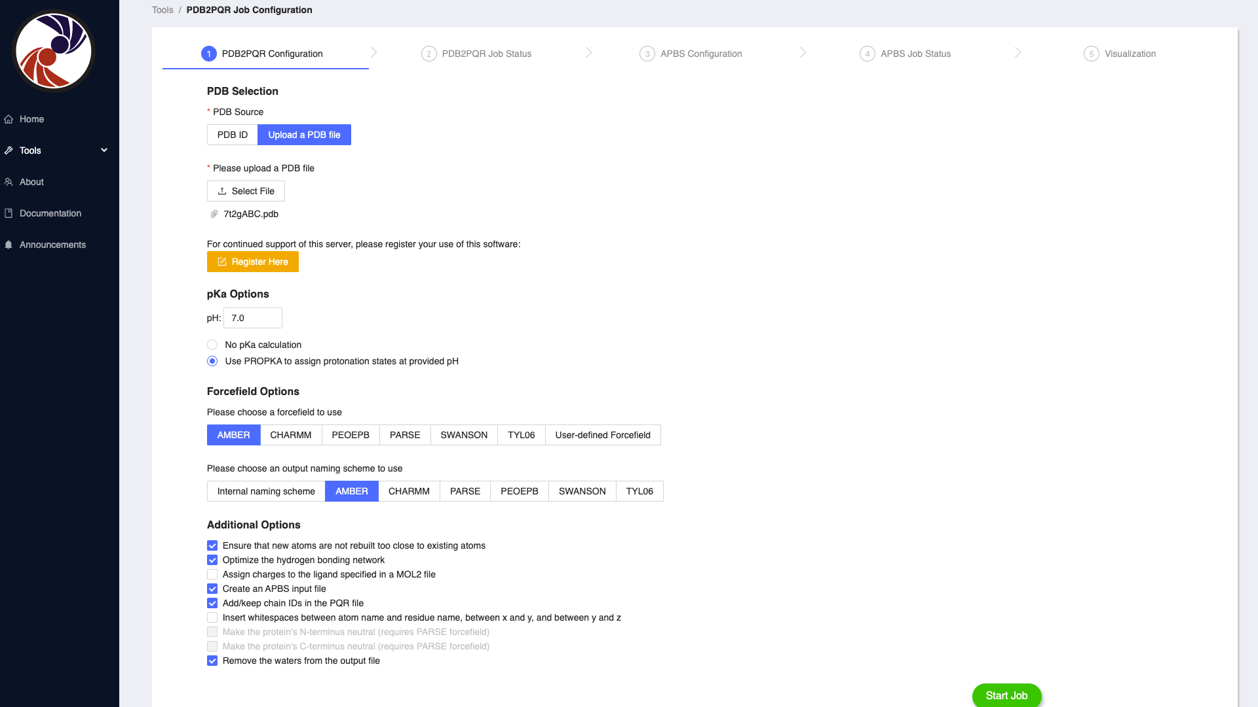

Slide 15
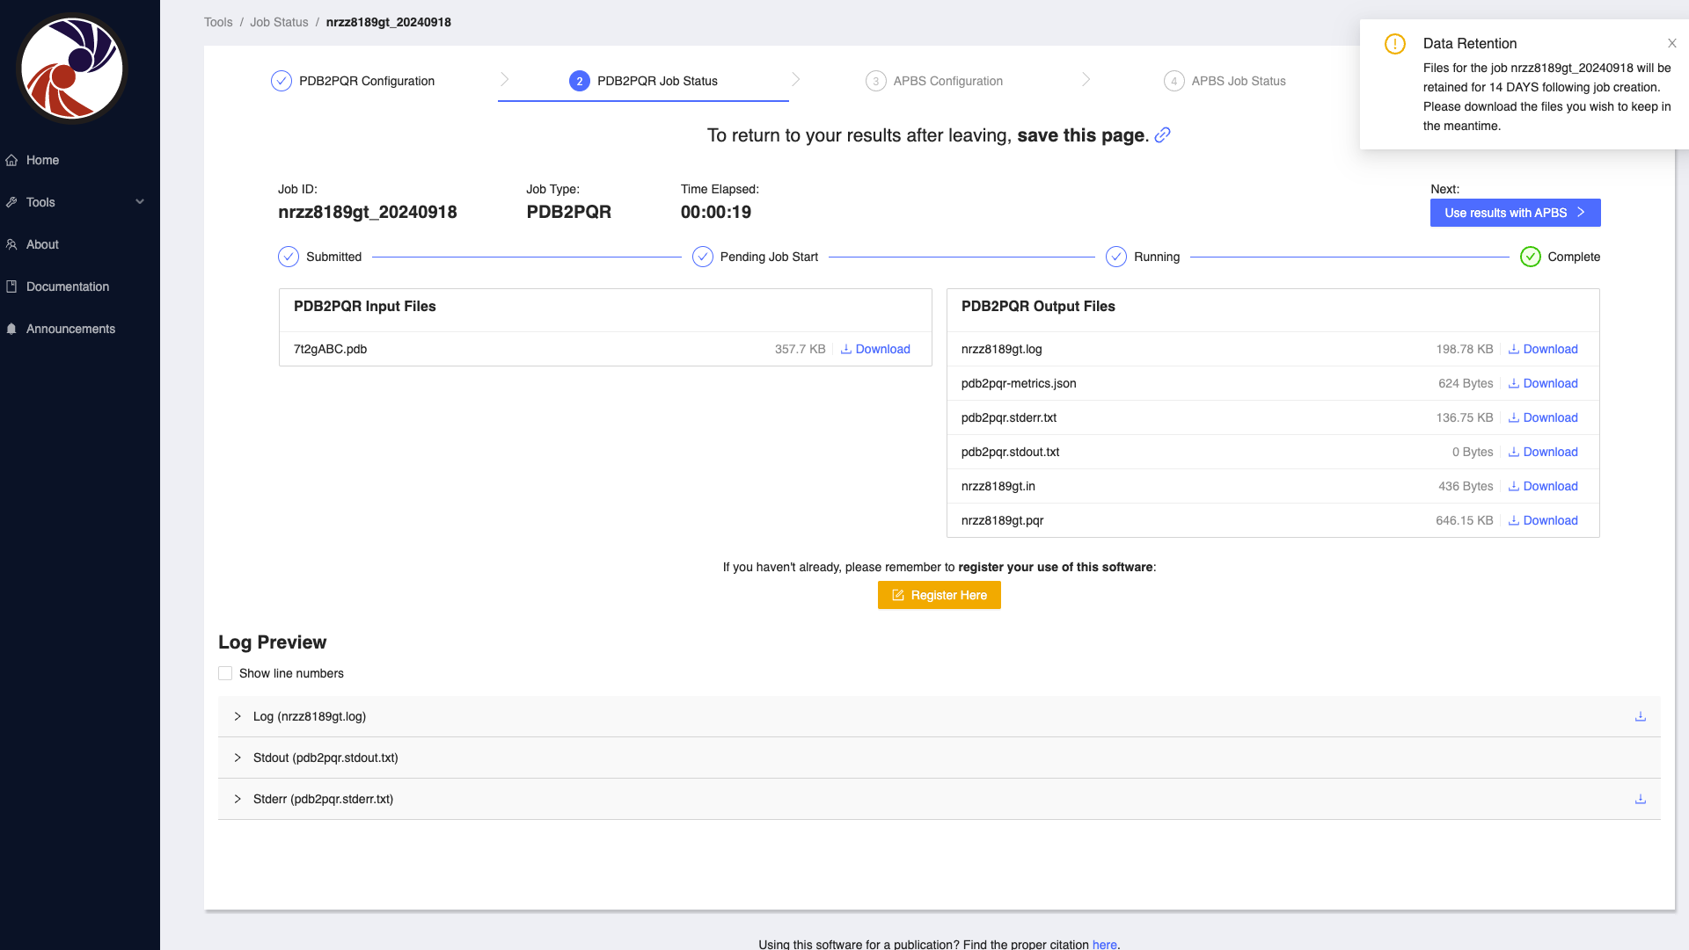

Slide 16
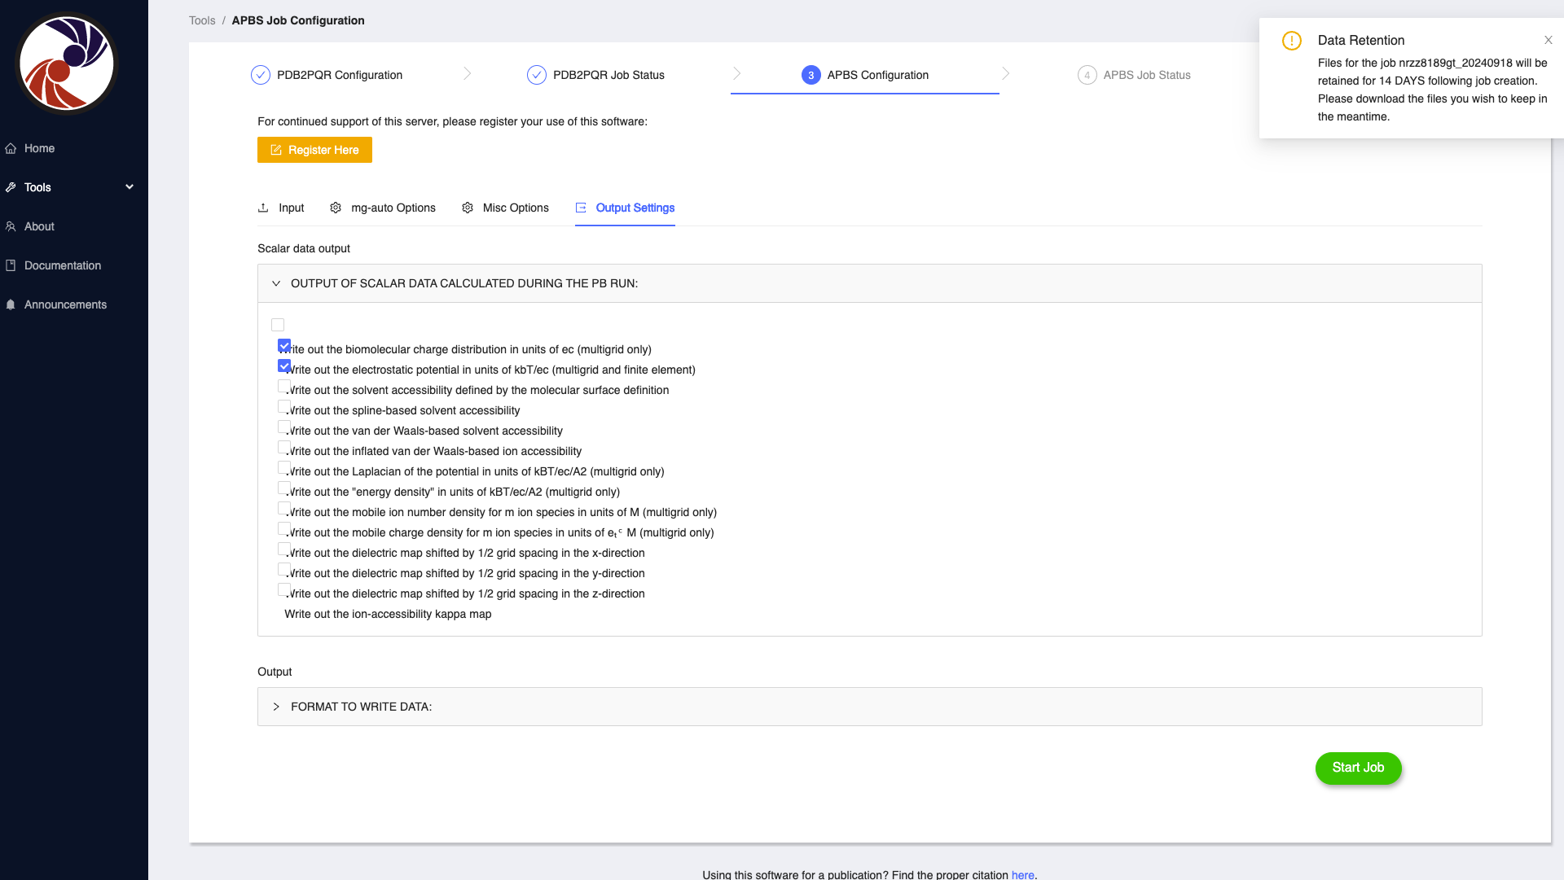

Slide 17
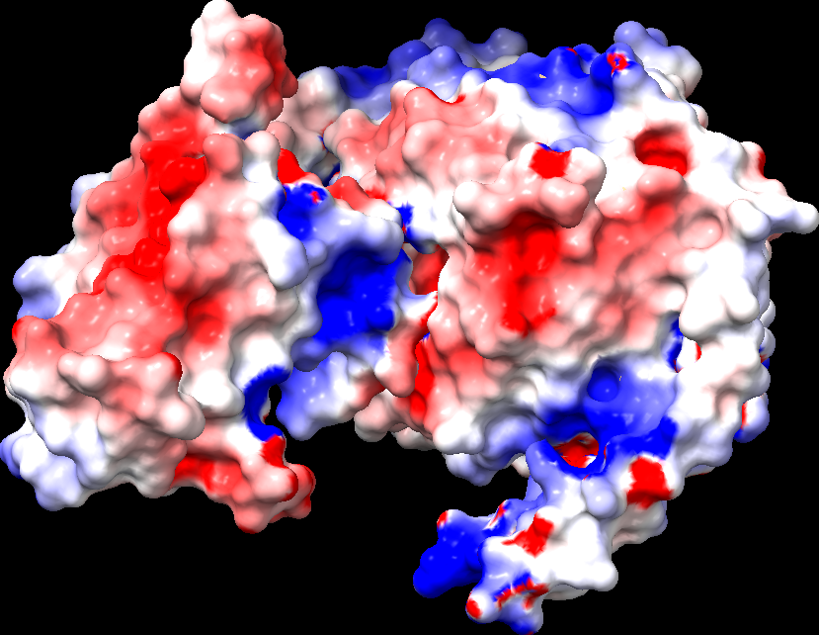
Visualization
Google Colab can show isosurfaces
The APBS web server shows the electrostatic potential at the protein surface.
UCSF Chimera X
can visualize volumetric data
or show the potential at surface (as on the right)
Visual Molecular Dynamics (VMD) has different representations for electrostatics
VolumeSlice
Isosurface

Slide 18
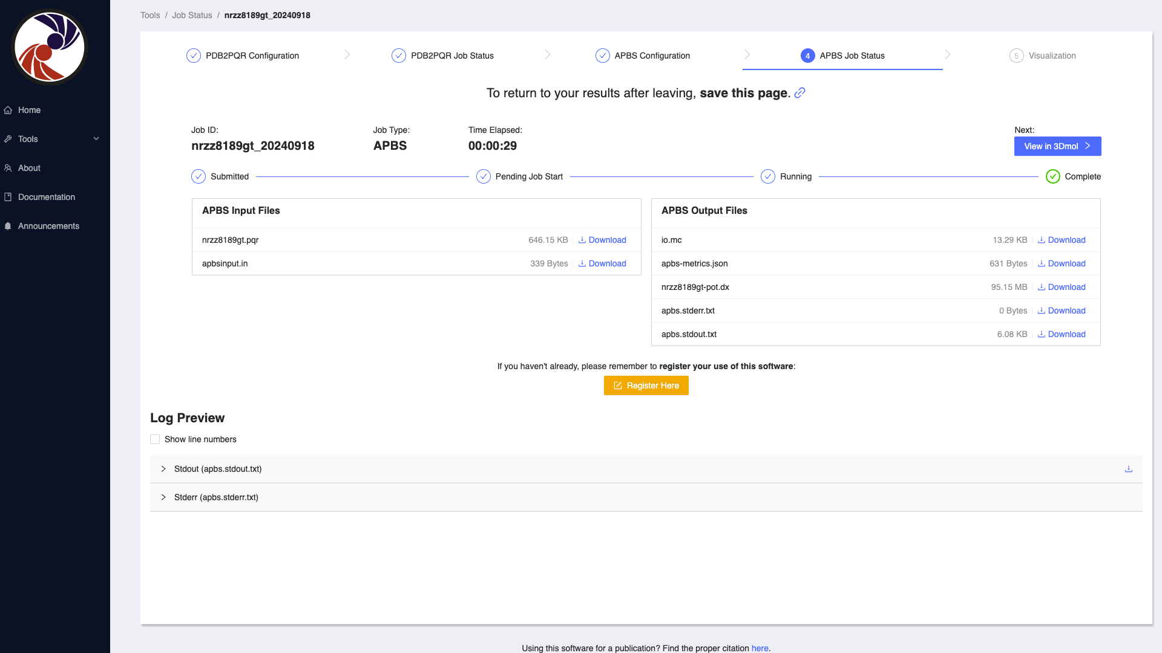
To view within 14 days of 9/17/2024:
https://server.poissonboltzmann.org/jobstatus?jobtype=apbs&jobid=nrzz8189gt&date=2024-09-18

Slide 19
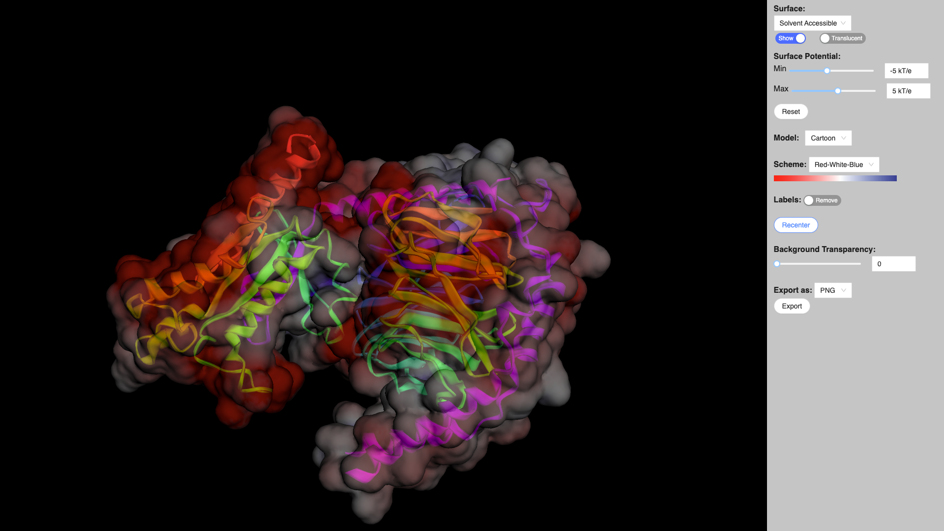

Slide 20
References
Garg, D.; Skouloubris, S.; Briffotaux, J.; Myllykallio, H.; Wade, R. C. Conservation and Role of Electrostatics in Thymidylate Synthase. Sci Rep 2015, 5 (1), 17356. https://doi.org/10.1038/srep17356, adapted under the CC BY 4.0 license.
Dindo et al (2017) https://febs.onlinelibrary.wiley.com/doi/full/10.1111/febs.14269
Baltoumas, F. A.; Theodoropoulou, M. C.; Hamodrakas, S. J. Interactions of the α-Subunits of Heterotrimeric G-Proteins with GPCRs, Effectors and RGS Proteins: A Critical Review and Analysis of Interacting Surfaces, Conformational Shifts, Structural Diversity and Electrostatic Potentials. Journal of Structural Biology 2013, 182 (3), 209–218. https://doi.org/10.1016/j.jsb.2013.03.004.

